Slide 1

Welcome Session
Mon 10th August
Notes:
Welcome everyone to our first session of the Community Pharmacy Management Programme.
My name is Adrienne Clugston and I’m Operations Manager for UCA-NI.
You have all just completed your first week of your community pharmacy placement and hopefully you have all settled in well into your pharmacy teams.
This morning, we are going to set the scene a little for you - give you a quick run through on community pharmacy in northern Ireland, this programme and how it sits alongside your NICPLD programme, and hopefully give you some useful information to set you up well for your foundation training year ahead.
You are being guided through your foundation training year by your educational supervisor, your pharmacy colleagues and by your NICPLD training programme.
Your employer has enrolled you onto the UCA programme – the Community Pharmacy Management Programme – as we cover some of the practical aspects of working life as a pharmacist and manager.
What you will learn through this programme will be how to put all your clinical knowledge into practice in terms of service delivery, the basics of pharmacy management and how to start thinking of yourself as a manager and leader in your profession.

Slide 2
Agenda
Welcome & introductions
Introduction to the UCA-NI
Aims, expectations & schedule for year
Educational Supervisor perspective
Trainee Pharmacist perspective
Who’s Who – Pharmacy organisations
Resources & Useful Links
Q&A
Takeaway thoughts

Slide 3

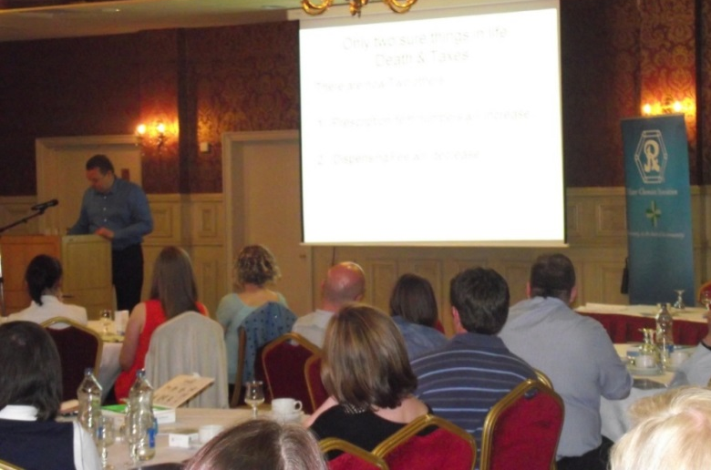
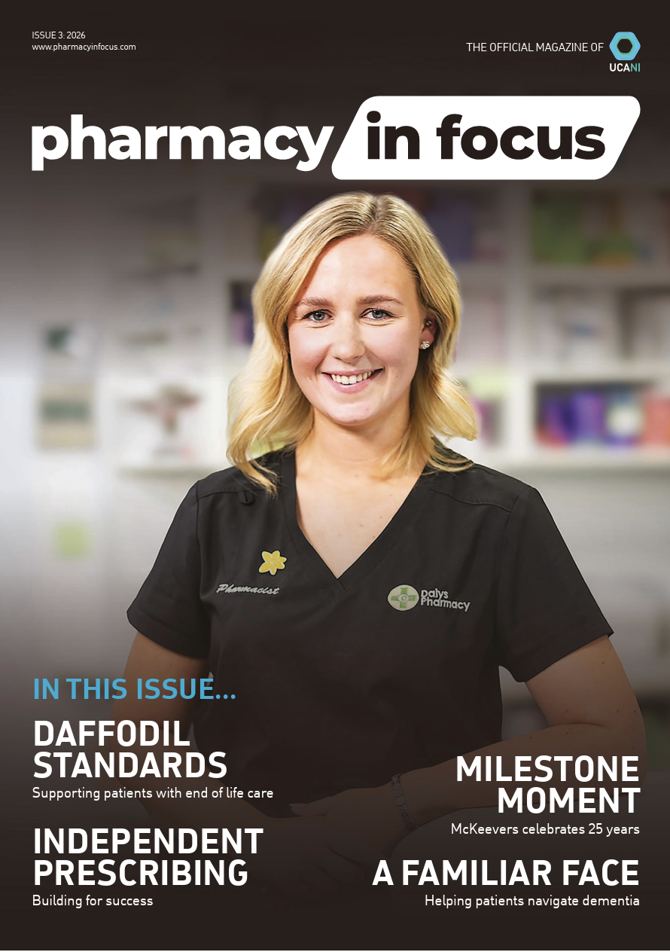





What does UCA do?
www.ucani.co.uk
Notes:
Who are UCA-NI and what do we do:
UCA-NI is a business support organisation for community pharmacies in northern Ireland – going from 1901
We provide Help & Support – Monday-Friday 9-5
Education & Training inc Foundation Training, CPD events, Vaccination Training, etc.
Communication – Pharmacy in Focus magazine which you should get in the shop & online
Associate database – you will now start to receive emails from UCA with information relevant to you
Social Media – Facebook, LinkedIn
LocumOnline – a free service for locums to find available vacancies
Pharmacy in Focus Awards ceremony – Awards entries launched later this year.
+ anything pharmacies and pharmacists need us to do
We have been supporting pharmacies and foundation trainees through ours Community Pharmacy Management Programme for many years.

Slide 4



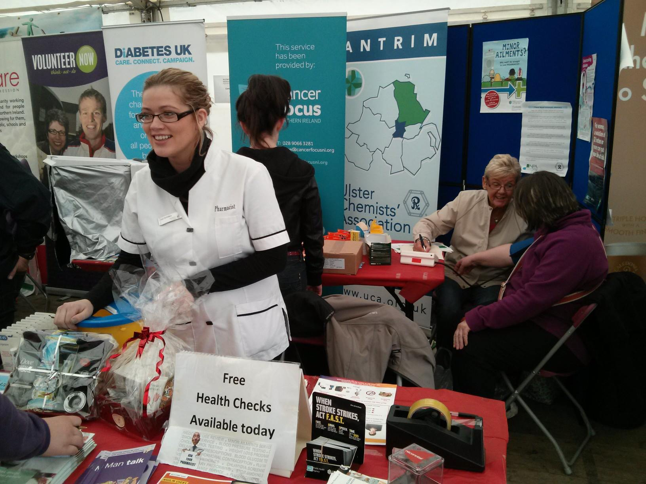
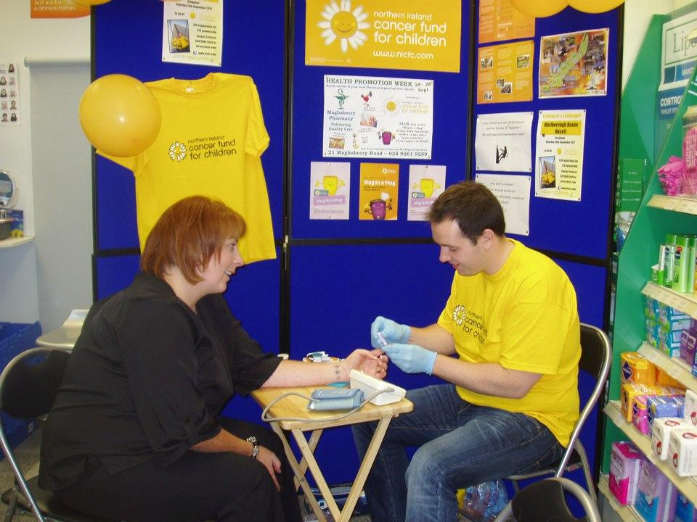
Notes:
The Foundation Training Year
It’s a busy year, but it will fly by, and you are advised to make the most of every opportunity that comes your way.
Get involved in everything that happens in your pharmacy this year whether it’s merchandising, purchasing, invoicing, charity events, health promotion events, talks to community groups, whatever. It’s a great way to learn and practice those important business and communication skills.
Fundamentally, community pharmacy is all about providing professional healthcare advice and services to produce positive outcomes for the individual and the community as a whole, so make sure you spend lots of time outside the dispensary as well as in it.

Slide 5
Introductions
Adrienne Clugston – Operations Manager
Cliff McElhinney – Education Supervisor
Beth McIlrath & Jacob Mizzi – Newly-qualified Pharmacists
Notes:
Our guest speakers today are:
Cliff McElhinney – Cliff is a very experienced Educational Supervisor and he is going to provide you with so much sound advice and direction to help you in the year ahead.
Beth McIlrath & Jacob Mizzi are newly-qualified pharmacists, who were sitting where you are this time last year. Beth completed her community placement with Cloughmills Pharmacy in Co Antrim and Jacob was with Pharmacy Plus.
As Beth & Jacob have so recently come through their Foundation Training Year they are very well placed to give you some insights and suggestions on how you go forward with your community placement and the year as a whole.
I will be available for you to contact throughout your time on this programme and at any time during the foundation training year.
If you need any help or support, I am here to help or signpost you to the best person to answer your query.
We will have a WhatsApp group too. This is there for you as a group to use – you can ask questions of each other, contact me, or let everyone know about something of interest.

Slide 6
Vaccination Training
Training Delivered by: AM First Aid
Saturday 19th SEPTEMBER (approx 10am-2pm)
Limavady venue – TBC
OR
Sunday 20th SEPTEMBER (approx 10am-2pm)
Belfast venue – UU Birley Building, York St, Belfast
Flu and Covid-19 Vaccinations – service info:
Community Pharmacy Vaccination Services - Business Services Organisation (BSO) Website
Notes:
I sent out an email last week with training dates including the Vaccination Training options
Most of you are opted in for vaccination training and you can choose from 2 dates – Sat 19th Sept in Limavady or Sun 20th Sept in Belfast. If you haven’t received that email, please let me know. Check your junk folder just in case.
So, anyone who hasn’t given me their choice of venue, can you do that asap please, so that I can finalise arrangements with the training company.
You will be trained in anticipation of Flu and Covid-19 services delivered in the Autumn – I think the service will start in early October.
There are 3 elements to the training – injection technique, knowledge & what to do if the person takes ill. The BLS/anaphylaxis element of the training needs to be refreshed annually – the rest is assumed will be kept fresh on a continuous basis. So this time next year, look out for emails offering Refresher training.
At the moment, in order for you to take a full role in the vaccination service, your pharmacy must use a “protocol” as opposed to the “PGD” and be appropriately insured.
UCA will email your ES and employers to clarify requirements if they wish you to vaccinate as a Foundation Trainee.

Slide 7
In-person training
Live Training Day 2: Mon 21st September 2026
Topics: Effective Pharmacy Business Management
Service Development
Live Training Day 2: Wed 11th November 2026
Topics: Successful People Management
Handling Complaints
Notes:
There are 2 full days of training in Belfast, and the day will run 9.30am – 4.30pm (no later) @ Malone Lodge Hotel, Eglantine Avenue, Belfast. For everyone coming up to Belfast for the vaccination training – sorry if you have to travel up again for the first training day the next day, or if you are staying up with friends and having a catch up – you’re welcome!
Parking is available on site – more details will be sent to you prior to each training day
I will provide tea-breaks and lunch – so make sure you let me know if you are vegetarian or vegan or if you have any special dietary requirements to ensure that we have suitable options for everyone. But if you want to bring your own snacks or water you can.
I will email the week before with more information, so please just hit reply and confirm your attendance.

Slide 8
Our Expectations
Punctuality
Active participation
FTY Portal on UCA website
Additional material
UCA website – www.ucani.co.uk
WhatsApp / Email
Notes:
What do we expect from you?
You are out of university now – you’re a pharmacy professional.
So, of course you are expected to approach this programme and any training in a professional manner.
The etiquette for online meetings, is to keep your camera on, barring technical difficulties of course, and sound off.
You can/should blur your background, or use a background picture that looks professional.
This shows you are ‘in the room’, and ready to participate
In meetings, and training, you will be expected and encouraged to contribute to group discussions
For in-person meetings, professional dress is always appreciated, NOW as our training days are all day, I do want you to be comfortable, so I’m not expecting to see you all in power suits
Presentations and additional material will be uploaded to the online portal afterwards - make use of any materials provided to you throughout the year, but you can always keep them for post-registration use.
Communications – I/UCA will only send you important information or requests on email/WhatsApp – please acknowledge or reply as promptly as you can. Keep an eye on your emails for any communications from various organisations throughout your FTY – and check your junk folder as your email may filter out emails from new sources.
You are all adults and this is not school. Your employers have paid for you to attend these training sessions as they see the benefit you will get from it. You may not see the benefit until you are working as a Pharmacist next year.
Discuss the content of this programme with your ES to ensure you get opportunities to put your learning into practice.
X-factor – you get two days out of the pharmacy, sitting down, you get to meet up with old friends and make new ones. And lunch is usually very good.
Most of all, we want you to enjoy the sessions and get the most out of them as you can. So, don’t be afraid to speak to me about any aspect of the training – if there are any issues, I will try to address them promptly.

Slide 9
Educational Supervisor Perspective
Cliff McElhinney
August 2026

Slide 10
What does a Healthy ES/ Trainee relationship look like?
Good two way communication – learn from student too; all leave something
The trainee knowing exactly what is expected of them from Day 1
A friendly working arrangement
The trainee feeling able to easily approach the ES about concerns within the workplace
The ES giving good non-critical advice when errors occur.

Slide 11
What do Educational Supervisors like to see in their trainees?
Enthusiasm
Well presented, professional looking young people who arrive on time
Good time management to get the job done in the allocated time
Flexibility
A willingness to learn; open mind

Slide 12
Areas of Concern
Lack of enthusiasm
Work shy! e.g. Portfolio
Overly modest / overly confident
Lack of communication
Unable to follow SOPs
Unable to action feedback

Slide 13
Portfolio and Exam
Start your portfolio if you haven’t already!
Continually look for ideas for portfolio standards to be met.
Use the cycles covered in your portfolio as opportunities to learn.
Ask your ES for ideas that you can use for your portfolio
Regularly have the ES check your portfolio
Start studying NOW for your exam.

Slide 14
Diary keeping
Have a diary to hand
New drugs
New disease states or response to symptoms
Ideas for the portfolio
Tasks that have been set by the ES

Slide 15
Self Development
Improve confidence
Improve assertiveness skills
Learn self-control when faced with difficult, unreasonable patients
Hone your skills on how to get along with people and work as part of a team
Notes:
If you have any questions for Cliff, or would like to discuss your specific situation, please get in touch with Adrienne on Adrienne@ucani.co.uk

Slide 16

UCA Welcome Session
Foundation Training Year
Jacob Mizzi and Beth McIlrath

Slide 17

FTY Experience
Beth
MPharm – Queen’s University Belfast
6 months community sector – Cloughmills Pharmacy
6 months hospital sector – Antrim Area Hospital
  Jacob
  MPharm – Queen’s University Belfast
  6 months community sector – McCoubreys Pharmacy Plus
  6 months hospital sector – Antrim Area Hospital

Slide 18
Settling in and getting started
Familiarise yourself with the pharmacy, workload and get to know your ES and the team
Keep an updated diary / calendar
-NICPLD development days, UCA days, appraisals, support meetings
Notebook
-Clinical / legal learning
Services / consultations
-Get involved as much as possible! Establish your own and your ES’s comfort zones
Study time
-Portfolio, start compiling notes / flashcards after a couple of months
Regular breaks

Slide 19

Portfolio tips
Start as early as possible
You will encounter scenarios that can be written up most days
Maximise learning outcome mapping in community
More MPAs to complete than in hospital, thresholds to be met at each quarter
Keep track
PA checklist available on NICPLD website, some LOs need mapped multiple times
Guides and resources
NICPLD website: Guide to learning outcomes and practice activities - advice on suitable scenarios for each PA and which LOs to map
Submit first drafts to ES
ES will review and advise on adjustments / approve for upload

Slide 20
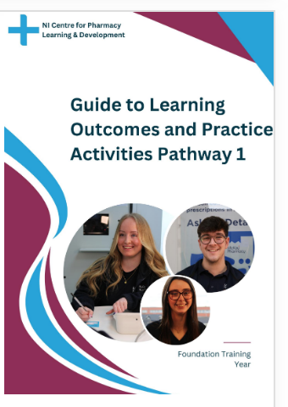
Responding to symptoms
Medicines-related query
3 to complete + observed practice template
3 to complete + observed practice template
Pharmacy First
Minor ailments
Emergency hormonal contraception
Sore throat
UTI
Shingles (pilot)
OTC
Alternatives e.g. stock shortage
Dosage form adjustment e.g. swallowing difficulty
Safe / accurate / correct administration
Drug-drug or drug-disease interactions

Slide 21

UCA Community Pharmacy Management Programme
-Focuses on community pharmacy from a management perspective:
Gives you confidence in your ability to be a team leader
Teaches strategies on effectively running a business and managing staff
Very helpful for learning law and ethics e.g. checking prescriptions
-In-person training days: Guest speakers, chance to network with fellow trainees
-Group chat: Trainees can use to support each other and ask questions
-Post-registration support: Regularly advertise job vacancies and locuming (LocumZone)

Slide 22
GPhC exam tips
Typically in mid-late June
Morning: 2 hours for 40 calculations questions
Minimum 1 hour lunch
Afternoon: 2.5 hours for 120 clinical questions
Start early: Mock exams and question banks, useful for timekeeping and exam technique
Calculations: Get a GPhC approved calculator, practice regularly

Slide 23
GPhC exam tips
Resources
Results
Free: NICE CKS, NICE guidance, NICPLD/Moodle
Courses: RevisePharma, MicroPharm and others (Free tasters available)
Social media: Daily flashcards and explanations
Try not to panic after the exam, you’ve likely done a lot better than you think!
Results usually in mid-late July
Repeat exam in November, plenty of support available including Pharmacist Support and PASS.

Slide 24
Community to hospital transition
Monday 1st February
Typical day: Medicines history/reconciliation, medicines review, counselling. Dispensing varies across hospitals, also opportunities to attend clinics.
DPP and ES: DPP oversees PPAs and PPP log, ES MPAs and appraisal. Both will support you throughout!

Slide 25
Community to hospital transition: Tips
PPAs can be much longer than MPAs, start these and your PPP log as soon as you can and allow plenty of time.
PPA4: Detailed account of prescribing consultation, single largest piece of work for portfolio.
PPAs can become major focus, remember MPAs too and plan with ES.
Check dress code before starting: Some allow smart casual and scrubs not always provided by hospital trust.
Make sure to set aside and book annual leave for exam as soon as you can.

Slide 26
Looking after yourself
FTY is a tough year: Often first year of full-time work, along with portfolio and exam revision.
Give yourself regular breaks from FTY and Pharmacy e.g. Saturday or a couple of evenings a week.
Spend time with friends and family
Keep in touch with fellow FTYs and friends from University
Be kind to yourself: Some days can feel worse than others, you’re probably doing a lot better than you realise!

Slide 27

Thank you for listening and good luck!!
If anyone has any questions, please get in touch, we are more than happy to help!
Emails
Beth – bethmcilrath@hotmail.com
Jacob – jmizzi1382@gmail.com
Notes:
If you have any questions for Beth or Jacob, you can email them – they are happy to help.
If you would like to have a chat with Adrienne about your specific situation, please get in touch on Adrienne@ucani.co.uk

Slide 28

Pharmaceutical Bodies And Healthcare Regulatory Organisations in Northern Ireland
Notes:
Last few slides cover who’s who and who’s doing what in pharmacy.
There is a whole eco-system around the pharmacy profession and services you provide. You are very familiar with your universities, but now as you move into the profession itself, there are many more organisations you will encounter, and many more acronyms – pharmacy loves an acronym!

Slide 29











Notes:
There are lots and lots of organisations working in and around pharmacy. They all have a specific function with some overlaps in terms of audience or geographical boundaries.

Slide 30
UCA-NI Ltd
Advice, support and signposting for community and primary care pharmacy across NI
4 Directors
Partnerships, e.g. PACT (Primary Care & Community Together)
Professional education & training events, including foundation training.
Social and networking opportunities
Business services & support
Locum Online
Notes:
More about UCA-NI…
We offer a range of support services for contractors, employee pharmacists and locums mainly.
In your early years as a Pharmacist, you are more likely to come into contact with UCA through our training programmes, events or as a locum, using our LocumOnline service.
Our strapline is Support Representation Communication – so as well as support services, we represent the business & professional interests of pharmacies & pharmacists on various stakeholder groups or partnerships. And we have a number of ways we communicate with everyone.

Slide 31
NI Pharmacy in Focus
Pharmacy in Focus is the UCA’s own magazine and communications channel in partnership with Pharmacy Shows
Print magazine 4 editions each year
PiF digital edition
Diary & Yearbook
Pharmacy in Focus Awards ceremony
Annual NI Pharmacy Show
Bi-annual Business Brunches
Recruitment service
Notes:
We have a magazine and diary under the title Pharmacy in Focus and we also have a number of events which we run through our publication & events partner – PharmacyShows.
We have two networking & discussion events each year - NI Pharmacy Brunch, the NI Pharmacy trade show in January and our Pharmacy in Focus Awards night in March. So lots of ways to help pharmacies to get together to network and help drive the sector forward.

Slide 32

Notes:
Community Pharmacy NI is UCA-NI’s parent company – they are the negotiating body for pharmacy contractors or owners.
They are in essence a trade union and liaise with DoH/SPPG etc on everything pertaining to the pharmacy NHS contact.

Slide 33
Community Pharmacy Northern Ireland (CPNI)
Negotiating committee for pharmacy contractors with government in NI
Represents pharmacy contractors on various stakeholder groups working with DoH, SPPG, etc
Merged with UCA in 2019
Publishes monthly list of concessionary prices
Flags key topical issues on website e.g. Brexit planning, drug shortages, etc.
18 Board members consisting of reps from contractors and LCGs inc 4 former UCA members
Notes:
CPNI send communications to the pharmacy owner/superintendent only – and they disseminate this information as appropriate. The weekly summary is particularly useful as it is a round up of all the important comms sent to pharmacies by SPPG and other organisations. That should be cascaded to all relevant staff.
NI Concessionary Prices
When there are shortages of drugs listed in the Drug Tariff, pharmacy contractors are often faced with dispensing an equivalent product which is only available at a higher cost than the set tariff price.
In this situation, a concessionary price may be offered (a new fixed higher than Drug Tariff price) to be applied for a particular month. Any prescriptions dispensed by the contractor would be reimbursed at the new agreed concessionary price, eliminating the need for endorsements to be made by the contractor. The prescriptions should be coded as normal. We will go through this in more detail at our first training day.
Concessionary prices are only applicable to the month in which they were granted. If there is an ongoing problem, it is possible that a new concessionary price will be permitted the following month, but this is not guaranteed. Once a concessionary price is agreed it will be published on the CPNI website.
Until a mechanism is in place for granting Northern Ireland concessionary prices, England concessionary prices will be automatically applied locally.

Slide 34
PSNI
Regulatory matters / Standards
Registration of pharmacists, trainees & pharmacy premises
Fitness to Practice
Run by Council - consists of a mix of registered pharmacists (registrant members) and lay members
Further information: Pharmaceutical Society NI
Notes:
The Pharmaceutical Society NI is the regulator, similar to the General Pharmaceutical Council in GB.

Slide 35
Pharmacy Forum NI
Sister organisation to the PSNI - responsible for professional leadership for pharmacy
Operates through a scheme of delegation as an arms length body to the Council of the PSNI
Responds to government consultations on behalf of the profession
Board elected by members for a 3 year term
Early Careers representation opportunities
CPD support
LOTS of useful resources on website!
See https://www.pfni.org.uk/
Notes:
The Pharmacy Forum is the professional representation body – it sits within PSNI but has some autonomy.

Slide 36

Notes:
The Forum also responsible for PASS – the Pharmacists Advice and Support Service
You will hear more about PASS from the Forum later in the year, but you can access support at any time.
The Foundation Training Year is an intense one. You are working full-time, on your feet all day, then going home to study in the evenings and at weekends. I know how that feels having done a whole degree while working full-time – it took me 4 and a half years! But you do need to balance that out with fun and relaxation, otherwise you can burn out. But all sorts of things can happen along the way from stressful times, to bereavement, to pregnancy, to financial hardships. PASS can offer help and support if you or a member of your family needs it. So don’t be shy about asking for help – that’s what it’s there for.

Slide 37
National Pharmacy Association (NPA)
Representative body for independent community pharmacies across the UK
Business and Professional support
Indemnity Insurance (malpractice cover)
Training for Pharmacy staff
Information zone e.g. travel vaccinations and malaria
Website access for members only – need login
www.npa.co.uk
Notes:
Similar to UCA but work on a UK-wide basis

Slide 38
Guild of Healthcare Pharmacists
National professional group within the health sector of the trade union Unite
For hospital and other NHS-employed pharmacists
Indemnity insurance (‘malpractice cover’)
Pharmacists’ Defence Association (PDA)
National organisation & part of Unite the union
Indemnity insurance (‘malpractice cover’)
Notes:
Other representative organisations

Slide 39
Royal College of Pharmacy
GB equivalent to the NI Pharmacy Forum
  “The Royal College of Pharmacy works to develop professional standards, guidance, learning and credentialing to support pharmacists and the wider pharmacy team to deliver safe, effective and patient-centred care.”
Notes:
The Royal Pharmaceutical Society of GB recently became a Royal College.

Slide 40
Strategic Planning and Performance Group (SPPG)
Formerly known as Health & Social Care Board (HSCB), now part of DoH NI
Arranges or ‘commissions’ health and social care services for the population of Northern Ireland.
Oversees work of primary and secondary care + social care
Integrated care = Neighbourhood Model of Care
Notes:
The Health & Social Care Board closed in April 2022 to be replaced by a new method of commissioning NHS services, through the SPPG which sits within Dept for Health NI. Lots of people still refer to this body as the “Health Board”.
DoH sets the strategic direction for pharmacy and SPPG commissions pharmacy services to achieve those strategic aims, i.e., decides what services are required and agrees a contract with providers, e.g., hospitals, GPs, pharmacies, BSO, Victoria Pharmaceuticals etc.
Look out for SPPG emails into the pharmacy regarding service announcements, product recalls, or shortages, etc.
Information usually disseminated through the secure Primary Care Intranet – ask your ES.
Current big strategy is Neighbourhood Model of Care. This is the move to integrating various health and care services provided through various sectors, and delivering more of them closer to patients’ homes. There will be 17 Integrated Neighbourhood Teams (INTs) which will include GPs, Pharmacists, Trusts, Social Care providers and voluntary sector. These teams will be responsible for delivering the Neighbourhood Model of Care and the initial focus will be on older people.
We are at the beginning of this process, the INTs are only now being set up, but something to keep a watch on, as it will affect the type of services you may be working on, whether you end up in hospital or community pharmacy.

Slide 41
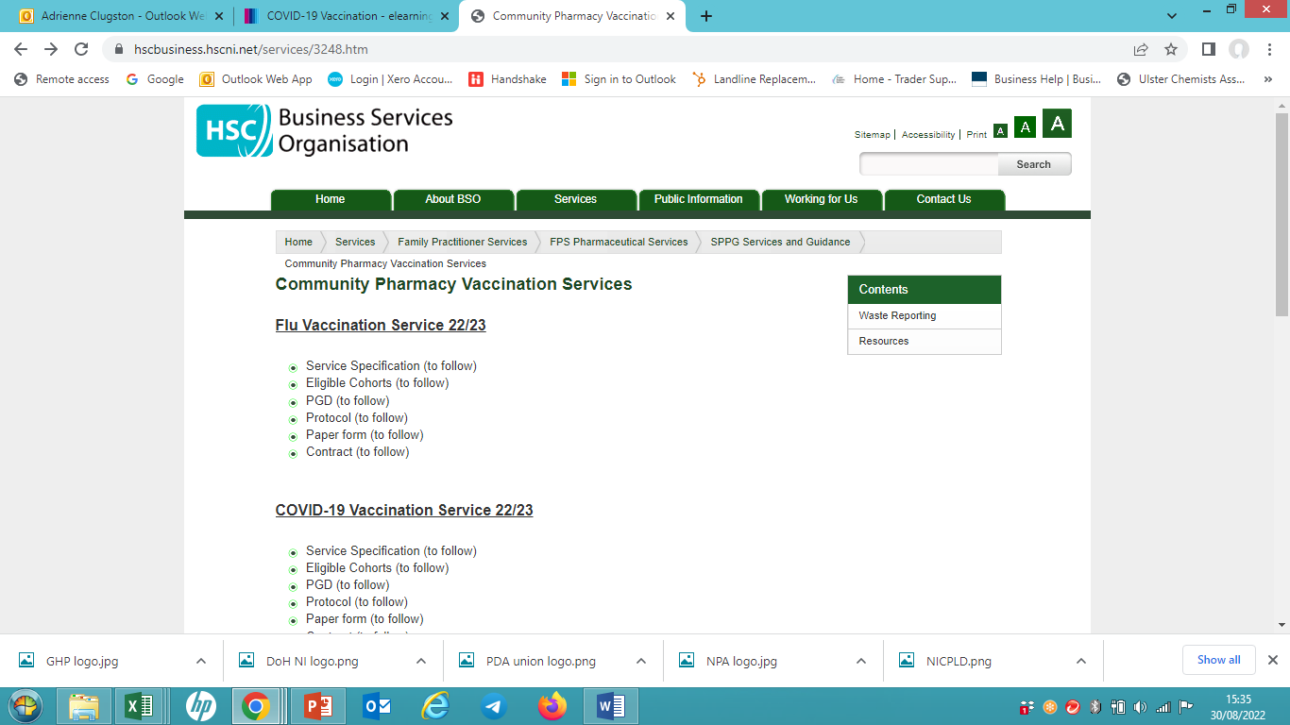
Notes:
Information about FPS Pharmaceutical Services are on the BSO website service information:
https://bso.hscni.net/directorates/operations/family-practitioner-services/pharmacy/
All service information
Contractor communications
Claim forms
etc

Slide 42
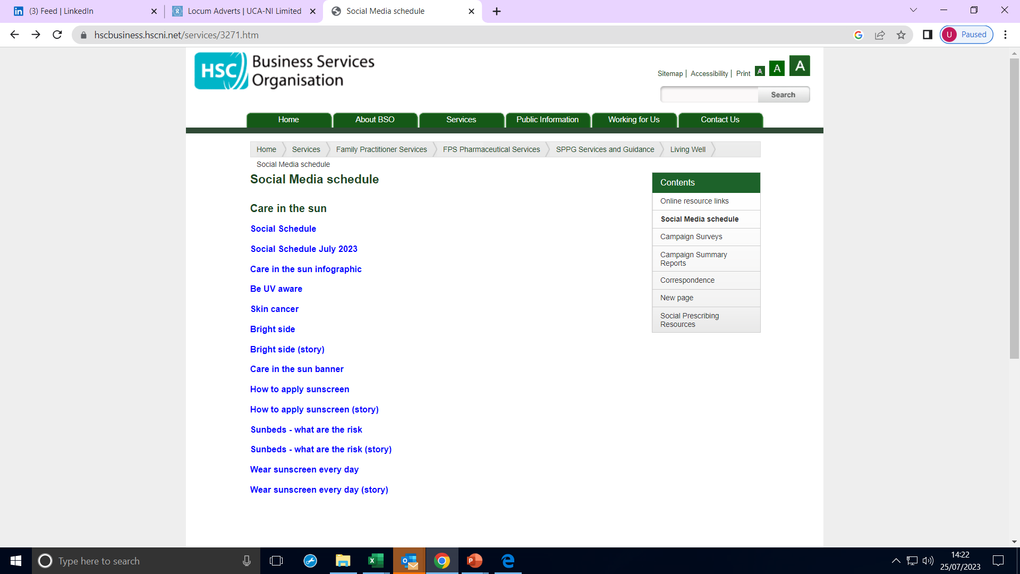
Notes:
Living Well service information
Social Media schedule & images

Slide 43
Community Development & Health Network (CDHN)
Empowering communities to improve health and wellbeing and reduce health inequalities
Building the Community-Pharmacy Partnership – aims to bring pharmacy and community together to reduce health inequalities using an asset-based community development approach
Notes:
Community Development and Health Network (CDHN) is Northern Ireland’s leading organisation working to empower communities, improve health and wellbeing and reduce health inequalities.
The main way you will interact with CDHN is through a BCPP project that your pharmacy might be doing.

Slide 44
Other Healthcare Regulatory Organisations:
Professional Standards Authority (PSA)
Medicines and Healthcare Regulatory Agency (MHRA)
Regulation and Quality Improvement Authority (RQIA)
Notes:
PSA – this is the overall regulatory body which regulates organisations such as PSNI
MHRA – the overall regulatory body concerned with the supply of medicines
RQIA – regulatory body in NI responsible for inspecting the availability and quality of health & social care services including nursing homes and pharmacy services.

Slide 45
Professional Development
Professional representation
Stakeholder bodies
Early career opportunities
Networking events
Notes:
You are on the frontline of providing pharmacy service, but there is whole lot of activity going on in the background.
Its good to be aware of what goes on but you can also get involved – from sitting on the Council of the PSNI or the Forum to getting involved stakeholder bodies.
Once you are registered, it’s a great way to develop yourself and develop the sector. It’s also a great opportunity to meet other pharmacists, including potential mentors and build networks.

Slide 46

Useful websites and resources

Slide 47
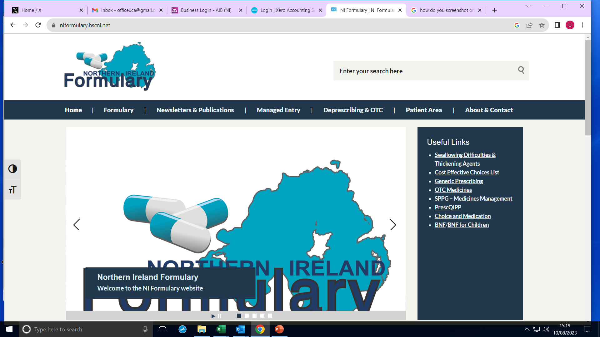
NI Formulary
Notes:
Get to know this one!
Medicines Management Monthly newsletters- UCA will send out, but you can also sign up to the newsletter yourself
Loads of great information onsite.

Slide 48
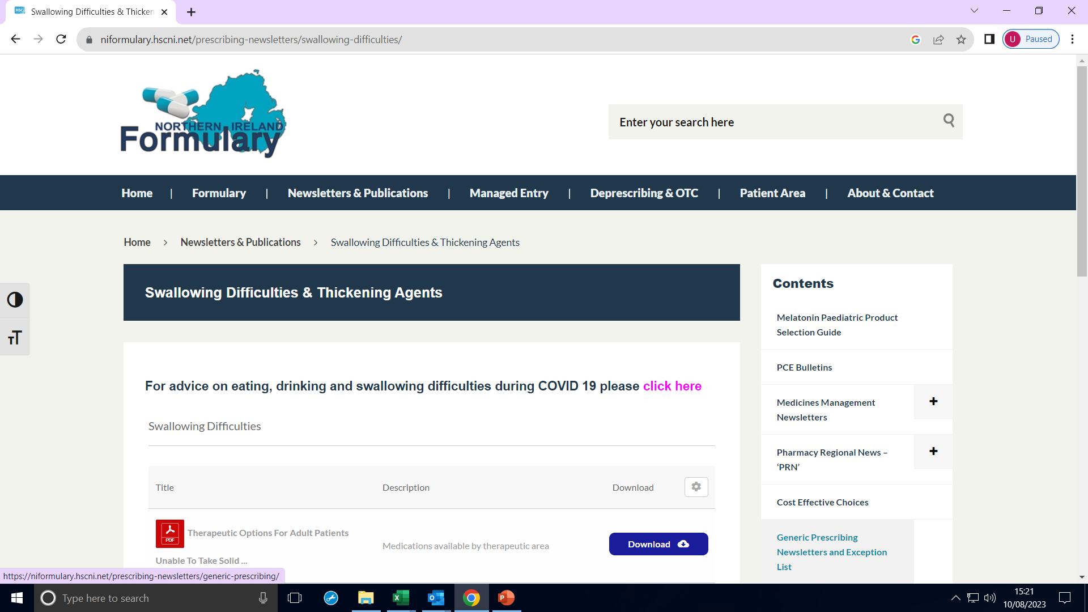

Slide 49
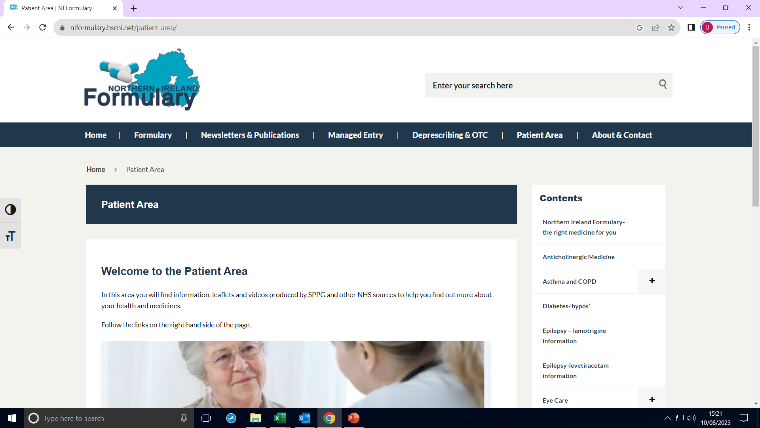
Notes:
Very useful signposting tool especially for patients who are newly diagnosed or started on a new medication

Slide 50
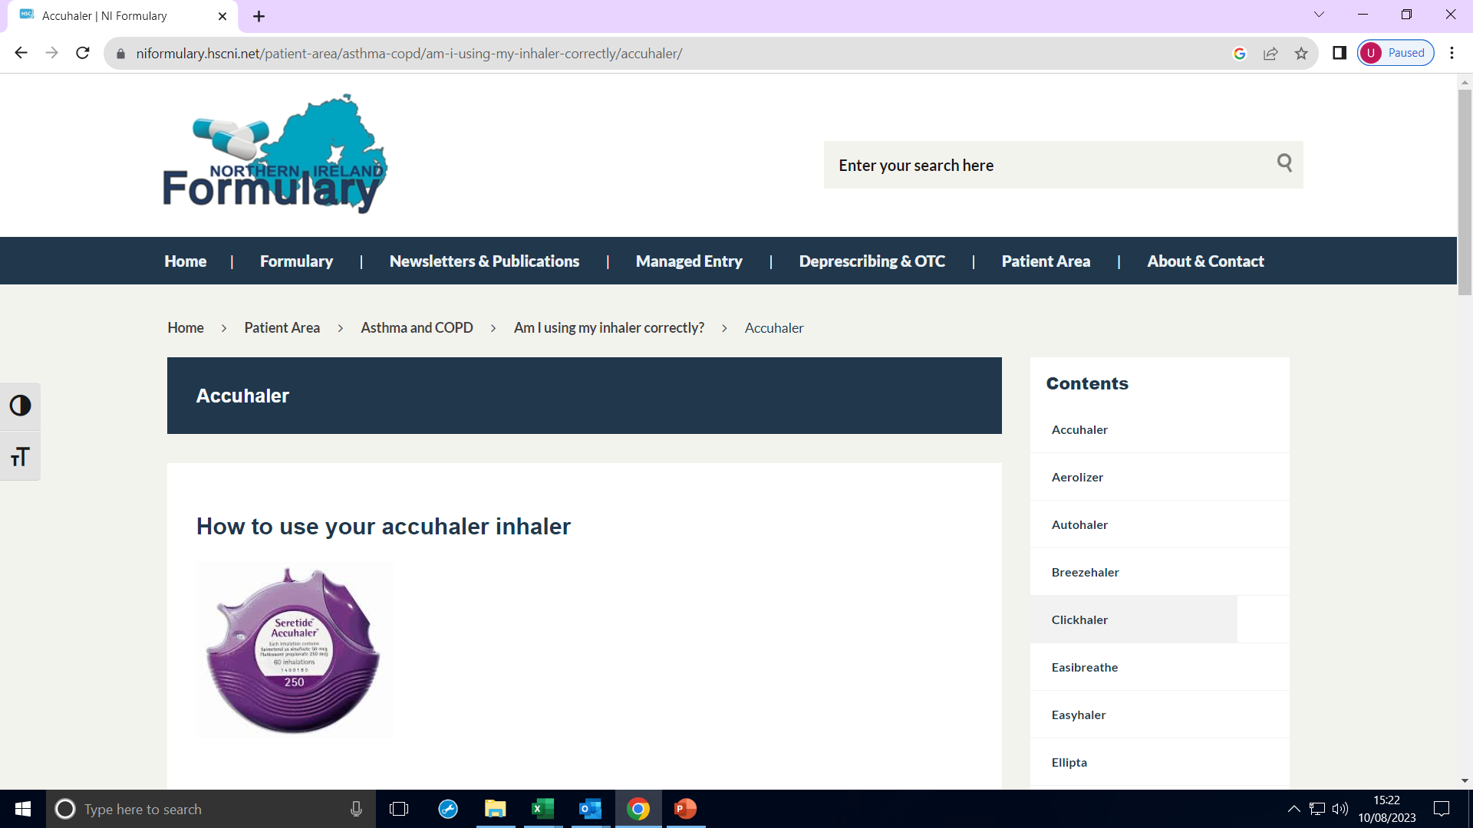
Notes:
Useful patient videos, which may be helpful to demonstrate during a patient consultation.

Slide 51
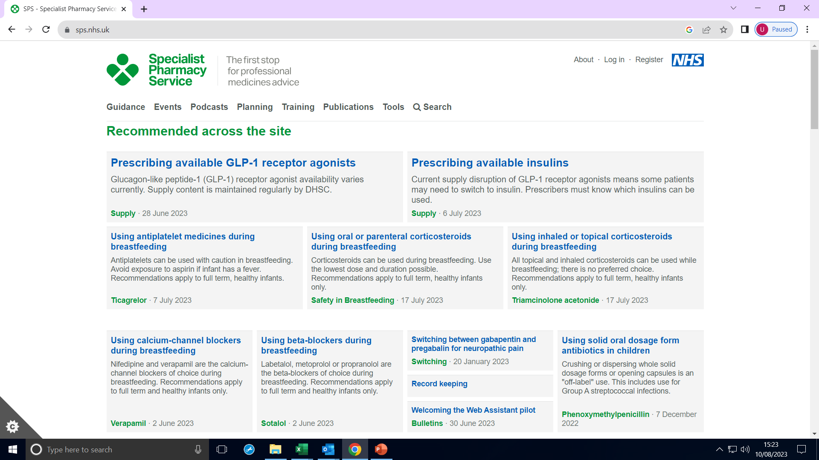
Notes:
Lactation safety
Medicines aid suitability

Slide 52

Notes:
Very useful tutorials for early career pharmacists- mapping to GPhC standards

Slide 53


Slide 54


Slide 55
Other resources
Patient.info
Rightbreathe.com
Asthma UK – British Lung Foundation
Diabetes UK
Parkinsons UK
British Heart Foundation bhf.org.uk
Notes:
Patient.info very popular symptom checker
Right to breathe asthma treatment pathways
Great resources to help you understand the patient perspective.

Slide 56
Resources contd.
Mims.co.uk
BNF app
OTC Consult
Social media groups- new Whats App group
You Tube / Instagram
Notes:
There are number of great pharmacists on social media now including a few from NI.

Slide 57
Take home message
Get to know all the organisations and what they are responsible for with the Pharmacy sector
Get to know the resources available to you
Get to know local resources in your area
Say hello in the WhatsApp group
Think about how you want your training year to go – what is your approach?
Get involved!
Notes:
Read through these slides in your own time and get to know how the pharmacy profession ticks
Make sure you are aware of what resources are available to you as a healthcare professional – what is going to make your life easier, and help you when engaging with patients.
What is happening in your local area? Who can you signpost to?
Check out CDHN’s website / get on to their email database
If you are in a rural location, there are resources from the Rural Community Network (RCN)
Your local Council might have business / community contacts & signposting + business training opportunities
Any questions please email or put in the WhatsApp group.
Overall, reflect on what you have heard this morning – the biggest message I always hear from outgoing FTs is that you get out what you put in.
Have a great FTY – throw yourself into it and enjoy the experience.
If you have any questions, please ask – there is always someone to help you, answer your questions and support you.

Slide 58
Next Training:
SAT 19th SEPTEMBER in LIMAVADY
OR SUN 20th SEPTEMBER in BELFAST
10am-2pm TBC
Topics: Vaccination Training
MONDAY 21st SEPTEMBER
9.30am-4.30pm Malone Hotel, Belfast
Topics: Effective Business Management & Service Development
Notes:
Reminder of our next training days.

